Slide 1

Extracting entities from Doctor’s Notes
Lucy lu, Ph.D
Notes:
I am going to introduce my project.

Slide 2
Outline
Introduction
Entity Detection
Classification
Future Work

Slide 3
Introduction
GPT
Instruction: Extract from {context}
  **Diagnoses**,
  **Medication**,
Instruction: Summarize {context} focusing on
  **Methodology**,
  **Significance**,
  **Weakness**,

Slide 4
Introduction
Challenges
  The meanings of words are Context-sensitive
  The combination of domain knowledge

Slide 5
Introduction
Entity Detection - Classification on words
  Words
  Sentences
  Paragraphs
Two solutions
  Entity Detection: Words
  Classification: Sentences
Applications
  Extract lab tests, medication, diagnoses, disease, etc.
  e.g., Albumin 0.9 (0.5-1.5) (Lab test name, quantity, reference)

Slide 6
Entity Detection

Slide 7
Introduction – Entity Detection
We propose a new methodology
  Combine Conditional Random Fields (CRF) Model with a domain specific feature set.
Featured CRF vs. rule-based and dictionary-based models
  Less missing patterns
  More expandable for new data
  Overcome rule-base and dictionary-based models in accuracy.

Slide 8
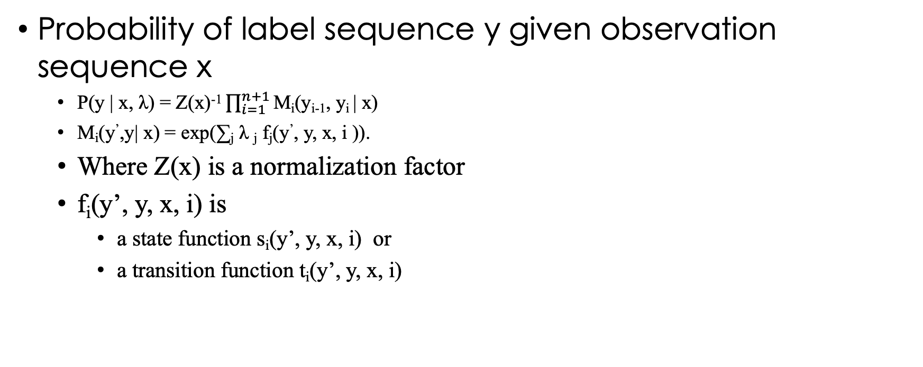
Definitions

Slide 9
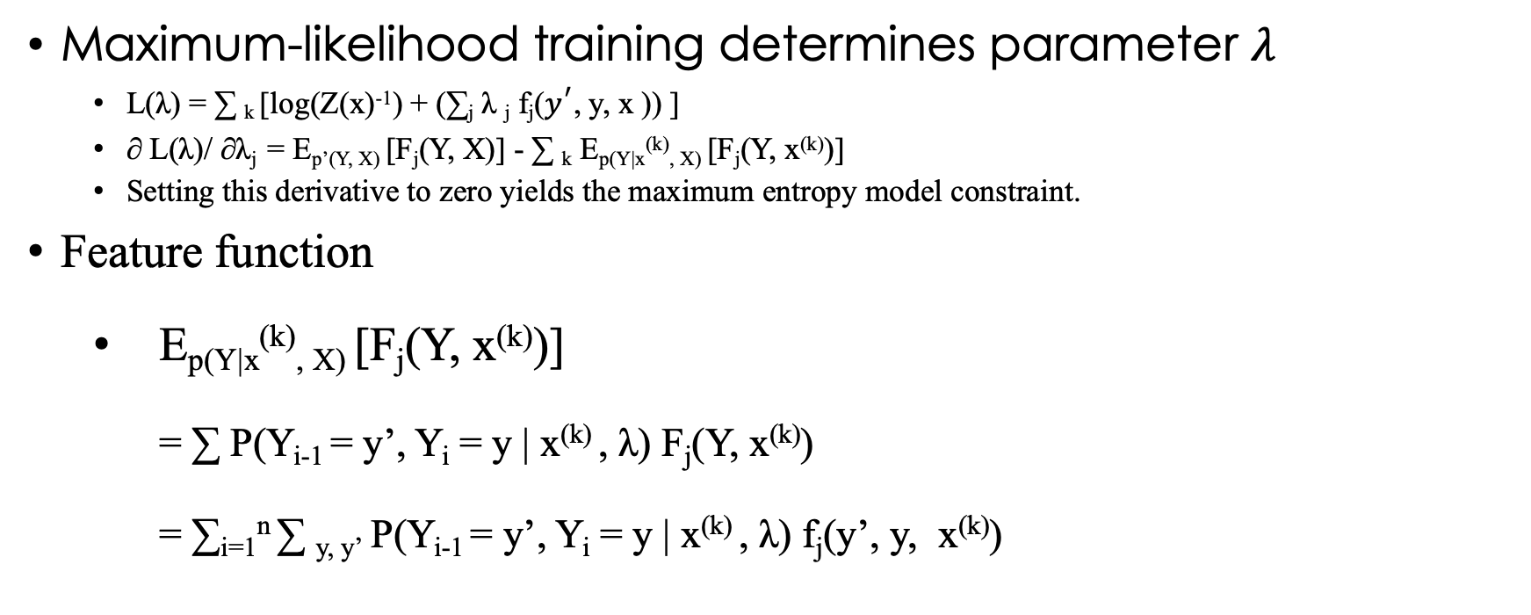
Definitions

Slide 10
Definitions

Slide 11
Definitions
Dynamic Programming to calculate P(Yi-1 = y’, Yi = y|x(k) , λ)
  P(Yi-1 = y’, Yi = y | x(k) , λ) = α i-1(y’|x) Mi(y’, y | x) β i(y|x) / Z(x)
  α0(y|x) = 1 if y = start; 0 otherwise.
  β n+1(y|x) = 1 if y = stop; 0 otherwise.
And the recurrent relations
  α i(x) = λ i-1(x)TMi(x).
  β i(x) = Mi+1 (x) λ i+1(x)

Slide 12
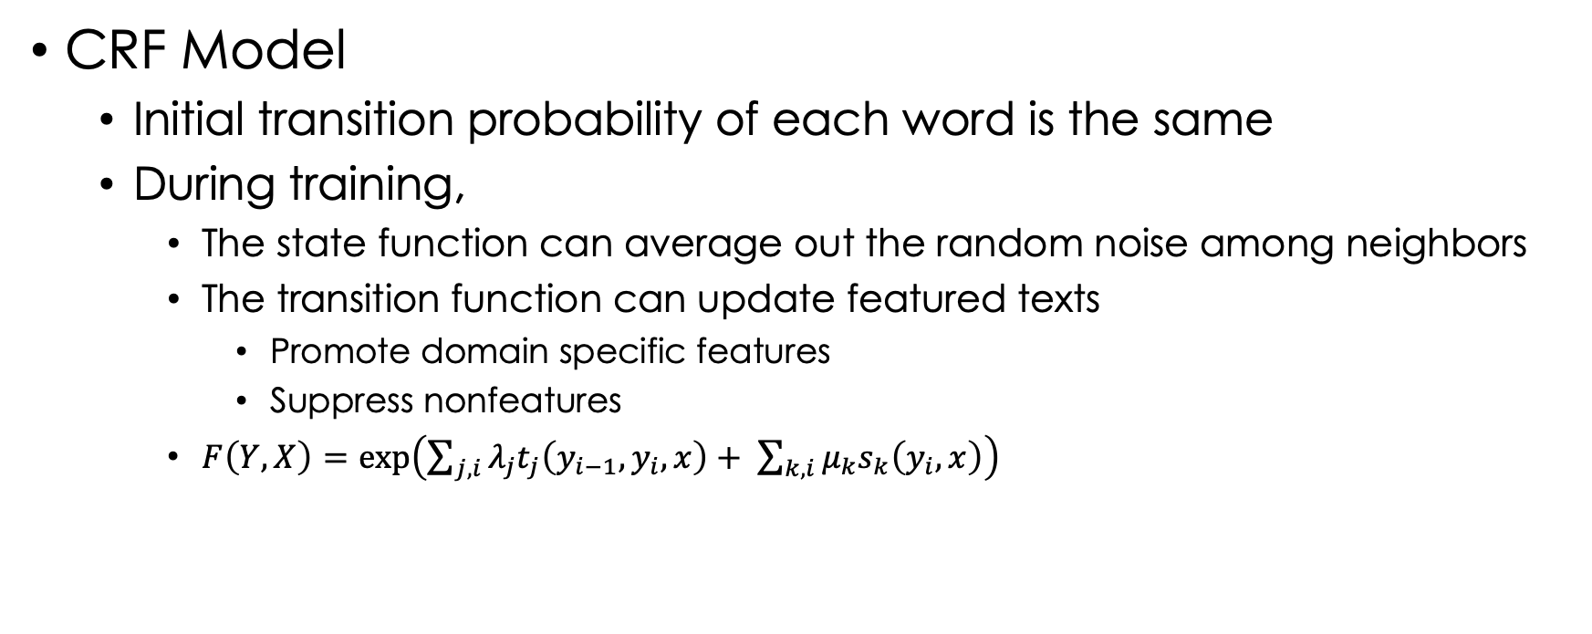
Methodology

Slide 13
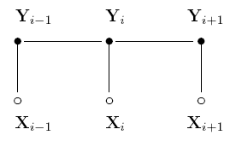
Methodology
Chain structured CRF model for sequences
  Each discrete random variable yi is conditioned on the observation sequence X.
  Y consists of several labels
  The maximum probability of the features determines the label sequence [Viterbi, A., 1967]

Slide 14
Methodology
Feature sets
  Related research: [Cunningham, H. et al. 2002], [Maynard, D. et al. 2003], [Abacha, A.B. et al. 2015]
  Global features
  Local features
  Derived features
  Domain specific features

Slide 15
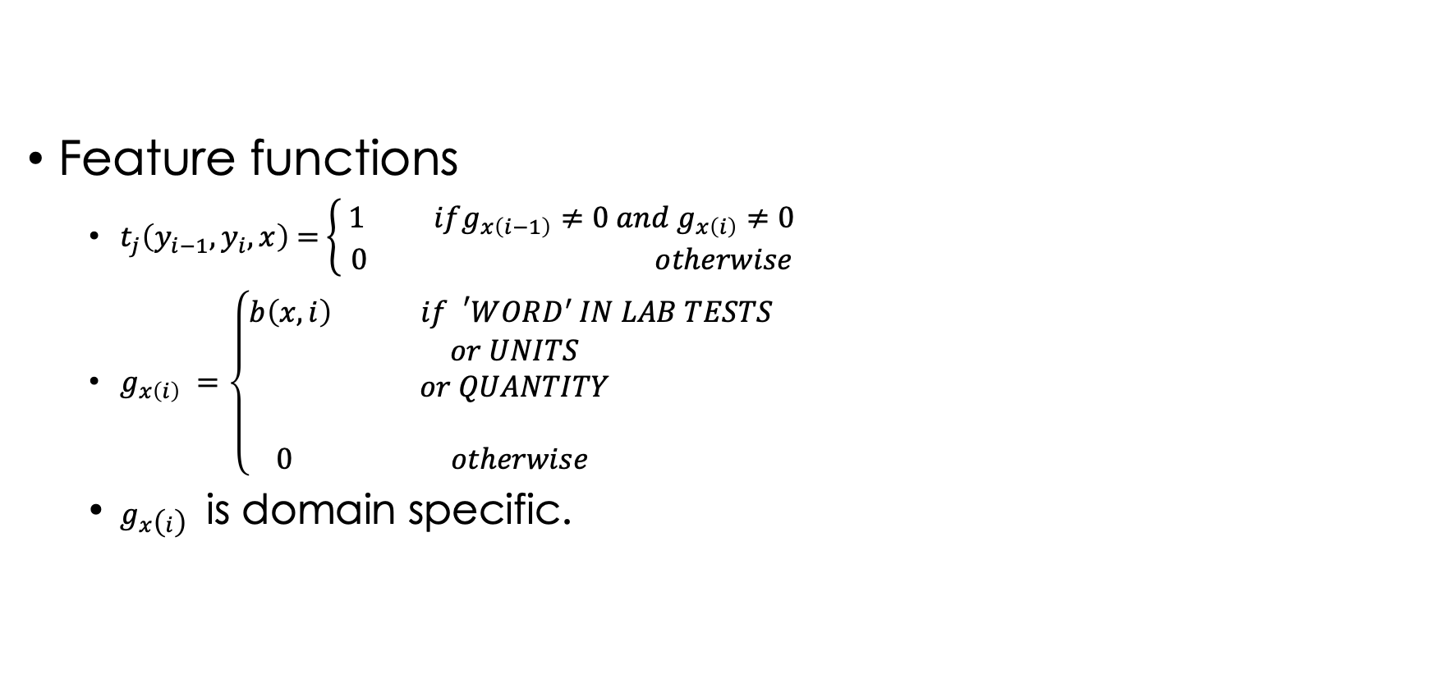
Methodology

Slide 16
Methodology
Characteristics of the domain knowledge
  Nouns
  Numbers
  Terms
  Units
Generally used Features:
  Part of speech tags (POS)
  Decimal and digital functions
  Unit dictionary
  Domain specific term dictionary

Slide 17
Performance
Machine Learning Architecture
Sample Set
    119,068 samples in total,
    33,806 samples for lab tests,
    546 out of 735 lab test names,
    374 out of 735 lab test names have more than 2 samples
Text
Pre-processing
Feature Extraction
Entity
Post-processing
CRF

Slide 18
Performance – Entity Detection
CRF
Character level Bi-LSTM
Evaluation
  CRF is more accurate than Bi-LSTM.
  CRF: predicted segments are 100% complete
  Bi-LSTM: predicted segments are 98.2% complete in which 657 out of 36,224 lab segments are not completely labeled as ‘LAB’
 | precision | recall | f1-score
O | 0.99998932 | 0.99993059 | 0.99995996
LAB | 0.99996233 | 0.9999942 | 0.99997827
macro avg | 0.99997583 | 0.9999624 | 0.99996911
weighted avg | 0.99997183 | 0.99997183 | 0.99997183
 | precision | recall | f1-score
O | 0.992 | 0.984 | 0.988
LAB | 0.990 | 0.995 | 0.993
macro avg | 0.991 | 0.990 | 0.991
weighted avg | 0.991 | 0.991 | 0.991

Slide 19
Summary
Introduced popular applications in Entity Extraction
Presented existing methods for Entity Extraction
Proposed a feature extraction methodology
Evaluated the performance of the methodology
Compared to Bi-LSTM model
  The accuracy of Featured CRF is 0.999 and Bi-LSTM 0.98

Slide 20
Entity Classification

Slide 21
Introduction - Classification
Traditional machine learning
  Maximum-likelihood vs. Minimum energy
  2 steps:
    Feature selection
    Model training

Slide 22
Introduction
We proposed Featured Transformer Model (FTM)
  Use Attention Mechanism
  Combine domain knowledge
  Solve missing feature issues
  Promote domain specific features.

Slide 23
Methodology
Input Layer: domain specific patterns
WBC 8.5 x/uL (4.5-9.8)
RBC 4.5 x/uL (0.5-5.0)
MCV 0.5 x/uL (0.0-5.0)
tramadol Allergy Intermediate hives
codeine Allergy Mild NAUSEA
WBC [NL] 8.5 x/uL [UL] (4.5-9.8)
RBC [NL] 4.5 x/uL [UL] (0.5-5.0)
MCV [NL] 0.5 x/uL [UL] (0.0-5.0)
tramadol Allergy Intermediate hives
codeine Allergy Mild NAUSEA

Slide 24
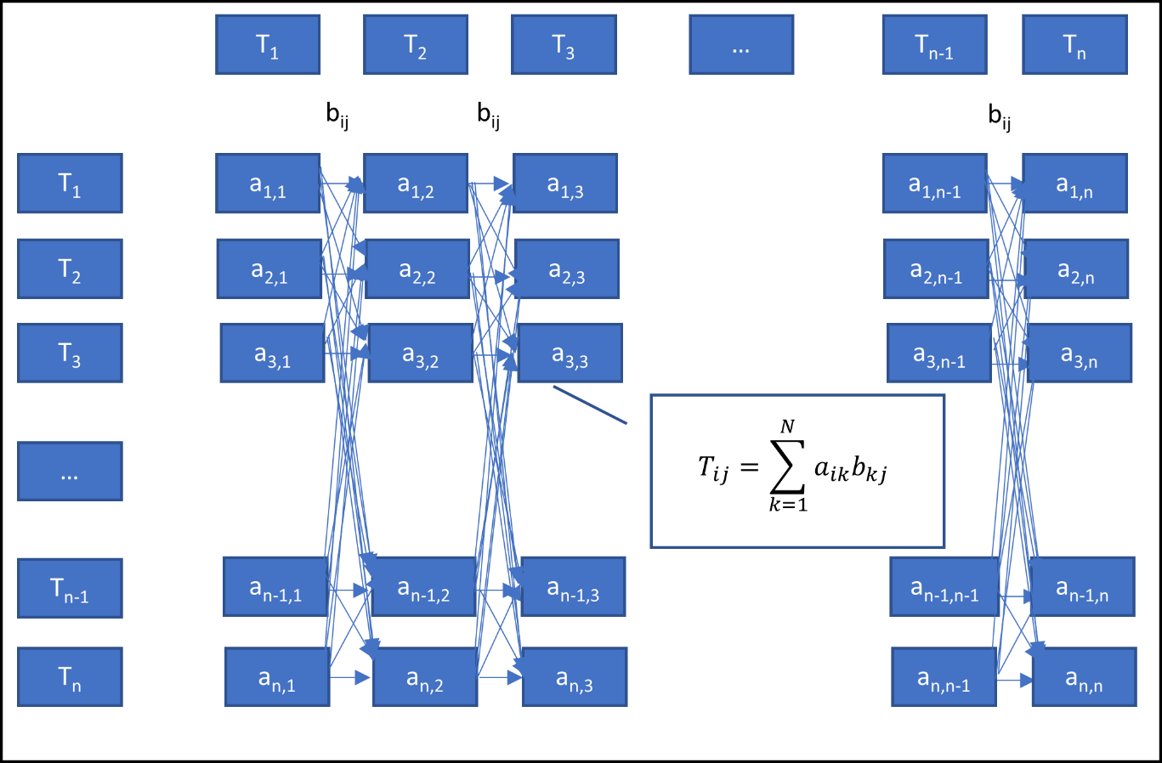
Methodology

Slide 25
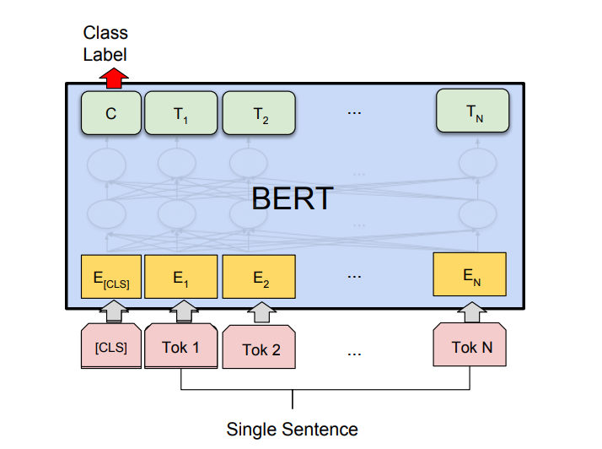
Methodology

Slide 26
Methodology
Advantage of Entity Features
  e.g., Name entity: [NL], Unit entity: [UL]
  Common features
  increase importance

Slide 27
Performance
BERT-Featured
CRF
 | Precision | Recall | F1-score
O | 1 | 1 | 1
LAB | 1 | 1 | 1
Accuracy | 1
Macro Avg | 1 | 1 | 1
Weighted Avg | 1 | 1 | 1
 | Precision | Recall | F1-score
O | 0.927 | 0.989 | 0.957
LAB | 0.959 | 0.764 | 0.85
Accuracy | 0.933
Macro Avg | 0.943 | 0.876 | 0.904
Weighted Avg | 0.935 | 0.933 | 0.931

Slide 28
Performance
BERT
NBSVM
 | Precision | Recall | F1-score
O | 0.99 | 0.99 | 0.99
LAB | 0.99 | 0.99 | 0.99
Accuracy | 0.99
Macro Avg | 0.99 | 0.99 | 0.99
Weighted Avg | 0.99 | 0.99 | 0.99
 | Precision | Recall | F1-score
O | 0.92 | 0.98 | 0.95
LAB | 0.99 | 0.97 | 0.98
Accuracy | 0.97
Macro Avg | 0.96 | 0.97 | 0.96
Weighted Avg | 0.97 | 0.97 | 0.97

Slide 29
Performance
LOGREG
FASTTEXT
 | Precision | Recall | F1-score
O | 0.92 | 0.96 | 0.94
LAB | 0.98 | 0.97 | 0.97
Accuracy | 0.96
Macro Avg | 0.95 | 0.96 | 0.96
Weighted Avg | 0.96 | 0.96 | 0.96
 | Precision | Recall | F1-score
O | 0.97 | 0.97 | 0.97
LAB | 0.99 | 0.99 | 0.99
Accuracy | 0.98
Macro Avg | 0.98 | 0.98 | 0.98
Weighted Avg | 0.98 | 0.98 | 0.98

Slide 30
Performance
BiGRU
STANDARD GRU
 | Precision | Recall | F1-score
O | 0.97 | 0.94 | 0.95
LAB | 0.98 | 0.99 | 0.98
Accuracy | 0.997
Macro Avg | 0.97 | 0.96 | 0.97
Weighted Avg | 0.97 | 0.97 | 0.97
 | Precision | Recall | F1-score
O | 0.98 | 0.98 | 0.98
LAB | 0.99 | 0.99 | 0.99
Accuracy | 0.99
Macro Avg | 0.99 | 0.99 | 0.99
Weighted Avg | 0.99 | 0.99 | 0.99

Slide 31
Performance
BERT-Featured performs better than CRF, BERT, NBSVM, LOGREG, BiGRU, STANDARD GRU.

Slide 32
Summary
Reviewed state-of-the-art solutions Transformer architecture,
Compared attention mechanism to Markov updates
Built Featured BERT on top of BERT
Evaluated Performance
  Proposed methodology
    Combine domain knowledge with input sequences
    Promote the importance of potential target samples
    Fix unlabeled data issues

Slide 33
Conclusion
Proposed two methodologies for entity classification
  term-level classification
  Sentence-level classification
Reviewed state-of-the-art research in entity classification
Reviewed Conditional models and Attention mechanism
Evaluated Performance

Slide 34
Future Work
RAG workflow enhancement
  Data Collection:
    web search - Filter results through classification (e.g. BERT)
  Retrieval:
    cosine similarity with two additional steps:
      extract Medical Entities (e.g. CRF, GLiNER)
      embeddings for Medical Entities (e.g. ncbi/MedCPT-Query-Encoder)
  Text Generation: GPT

Slide 35
Thank you
Q&A

